Slide 1
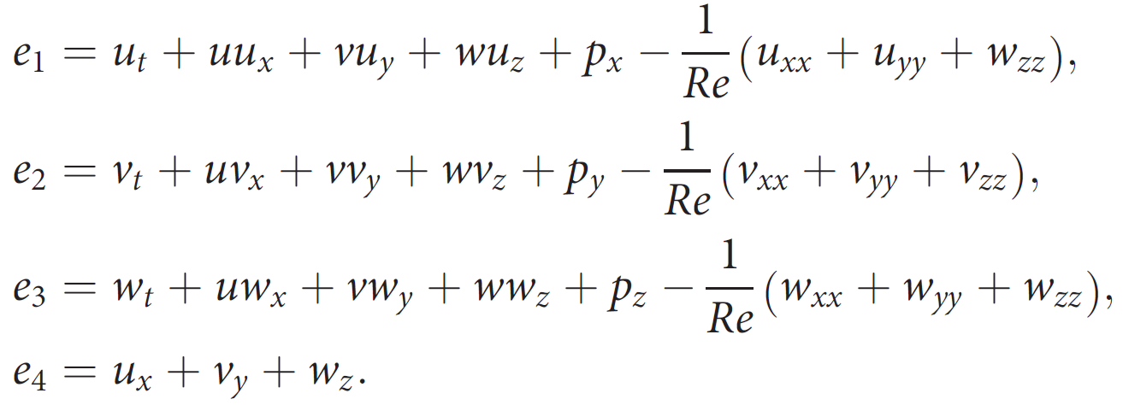
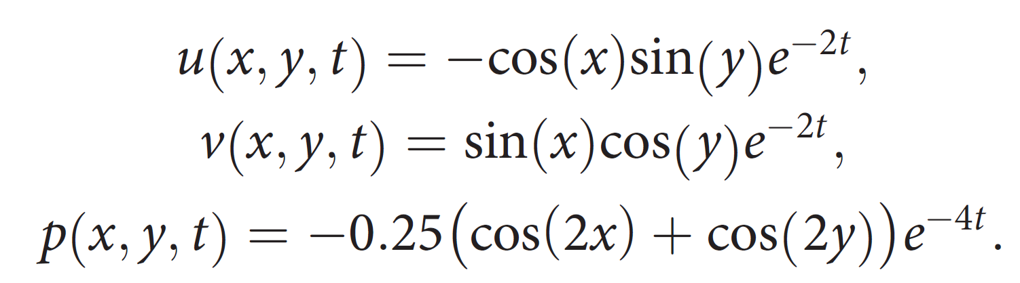
the residuals of the N–S equations can be expressed by the network as：
2D Taylor’s decaying vortices：(An analytic solution)
The computation is carried out in the domain of 0<x, y<2pi,and 0<t<2. The Reynolds number Re is equal to 1.

Slide 2
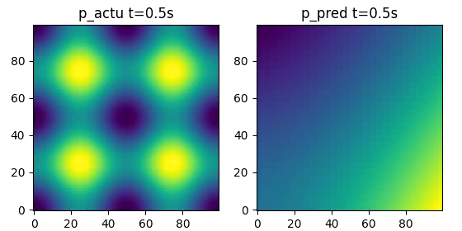
0<x, y<2pi, and 0<t<2, in the space of x, y, t:
1.Give uv of random 256 points:

Slide 3
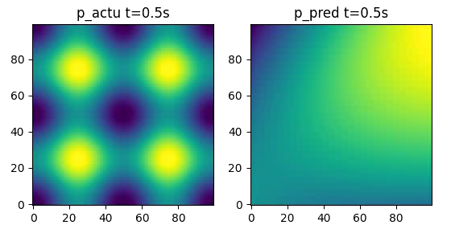
0<x, y<2pi, and 0<t<2, in the space of x, y, t:
2.Give uv of random 128 points:

Slide 4
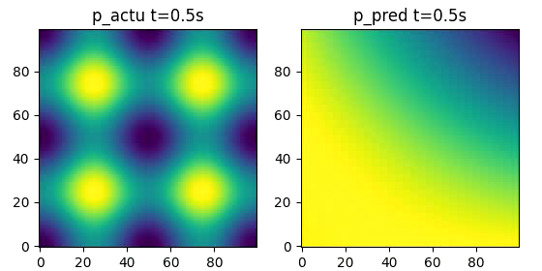
0<x, y<2pi, and 0<t<2, in the space of x, y, t:
3.Give uv of random 64 points:

